Slide 1
Investigations: Strategies and Recommendations (Hints and Tips)
Leah Lane, CFE
Director, Global Investigations, Texas Instruments, Inc.

Slide 2
Global Investigations
When Allegations First Arise
There is no single set of ground rules for conducting internal investigations inside or outside of your home country.

Slide 3
Global Investigations
Management Will Want to Know:
Is it really a fraud and who is involved?
What is the loss?
How did it occur and has it been stopped?
How was the fraud identified?
Will the fraud impact the brand or customer?
Do you anticipate media coverage?
Are their regulatory reporting requirements?
Should law enforcement be contacted?

Slide 4
Strategy: What to Actually do First…..
Engage Legal/Outside Counsel
Privilege/Work product
Notify Proper Executives
Investigative protocols

Slide 5
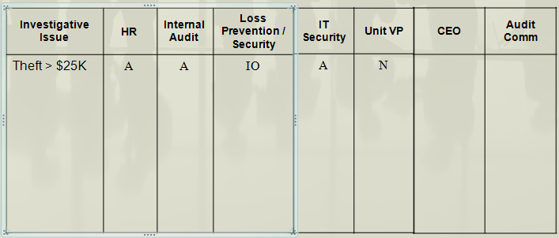
Example of Investigative Protocols

Slide 6
Strategies and Recommendations: What to Do …….
Investigative Plan
What are the allegation(s)?
Location of the violation(s)?
Political and corruption environment?
Investigative resources
Internal vs. external
Language assistance
Does local law, U.S. law or both apply?
Are there regulatory agency requirements?

Slide 7
Contact the Complainant
Follow Up with Additional Questions
Request a Face-To-Face Meeting
If Anonymous Tip via Email, Reply Anyway
Confidential Conference Call

Slide 8
Strategies and Recommendations: What to Do …….
Stop the Activity, if Appropriate

Slide 9
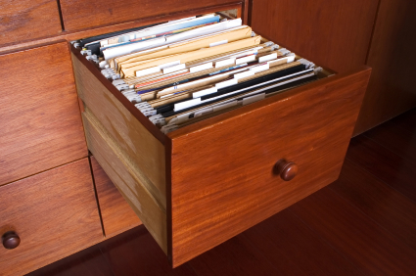
Strategies and Recommendations: What to Do …….
Capture and Preserve Relevant Documents and Electronic Media
Data protection / Privacy laws
Litigation holds
Notification
Custodians and IT
Suspend any deletion protocols

Slide 10
Strategies and Recommendations: What to Do …….
Legal Confidential Communications Privilege
Types of privilege
Is the legal confidential communications privilege concept valid or applied differently in the jurisdiction?
Are there obligations to report allegations to authorities?
Does updating your U.S. based attorney wave privilege under local law?

Slide 11
Strategies and Recommendations: What to Do …….
Operational Considerations
Confidentiality
Who should lead the investigation?
Internal vs. external investigators
Internal; group with jurisdictional responsibility
Investigative support
Key witness and subject availability- vacation, medical, holiday

Slide 12
Recommendation: Avoid Tipping Off the Fraudster
Confidentiality Policies and Forms
“Need to know” clause
NLRA – U.S. only
Know What to Do if Fraudster is Tipped off Early

Slide 13
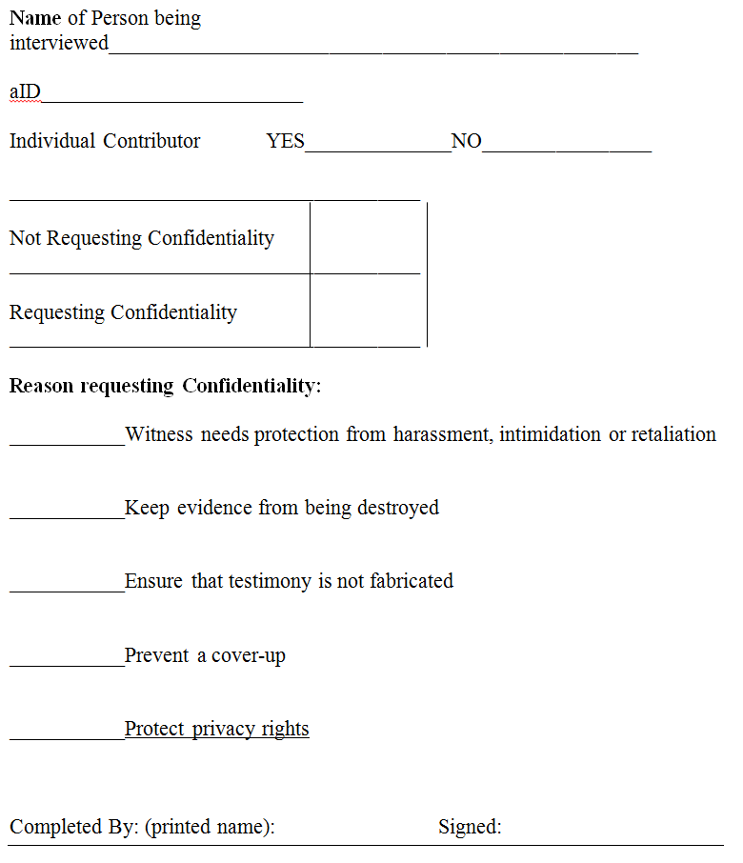
Example of U.S. Interview Form

Slide 14
Strategies and Recommendations: Interviewing
Be Cognizant of What is Allowed by Law and What is Acceptable Culturally
It Must be Clear to the Interviewee the Interview is Voluntary and the Interview can be Terminated at Anytime
Do Employees and/or Contractors have an Obligation to Cooperate or Right to Refuse
Failure to cooperate my result in disciplinary action

Slide 15
Strategies and Recommendations: Interviewing
Union Representative, Works Council or Third Party Representatives
Prior Notification vs. Surprise
Generally best not to notify
Must confirm interviewee’s availability during the pre-investigation

Slide 16
Strategies and Recommendations: Interviewing
Written Statement
Native language (statement translation as soon as possible).
Statements are evidence.
Provide a copy to the employee?
Audio Recording Interviews
Is audio recording a prudent strategy ?
Would audio recordings be discoverable or protected?

Slide 17
Strategies and Recommendations: Findings/Final Reports
Consult with Legal Regarding the Findings and Final Report Format
Verbal report
Written report
Prepared by the investigative team?
Prepared by an attorney with assistance from the investigative team?

Slide 18
Strategies and Recommendations: Findings/Final Reports
Human Resources
What documentation is required to move forward with employee or contractor disciplinary action?
Verbal report?
Written summary for each person?
Are copies of backup documentation required?
Ensure copies of polices used for disciplinary actions are included in the case file.

Slide 19
THANK YOU
QUESTIONS?

